Slide 1


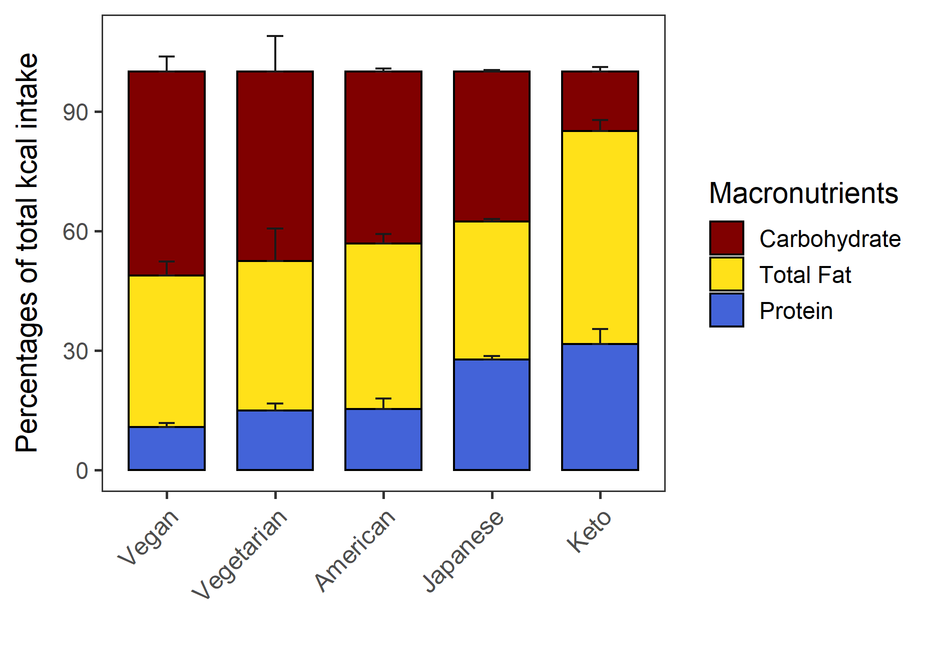
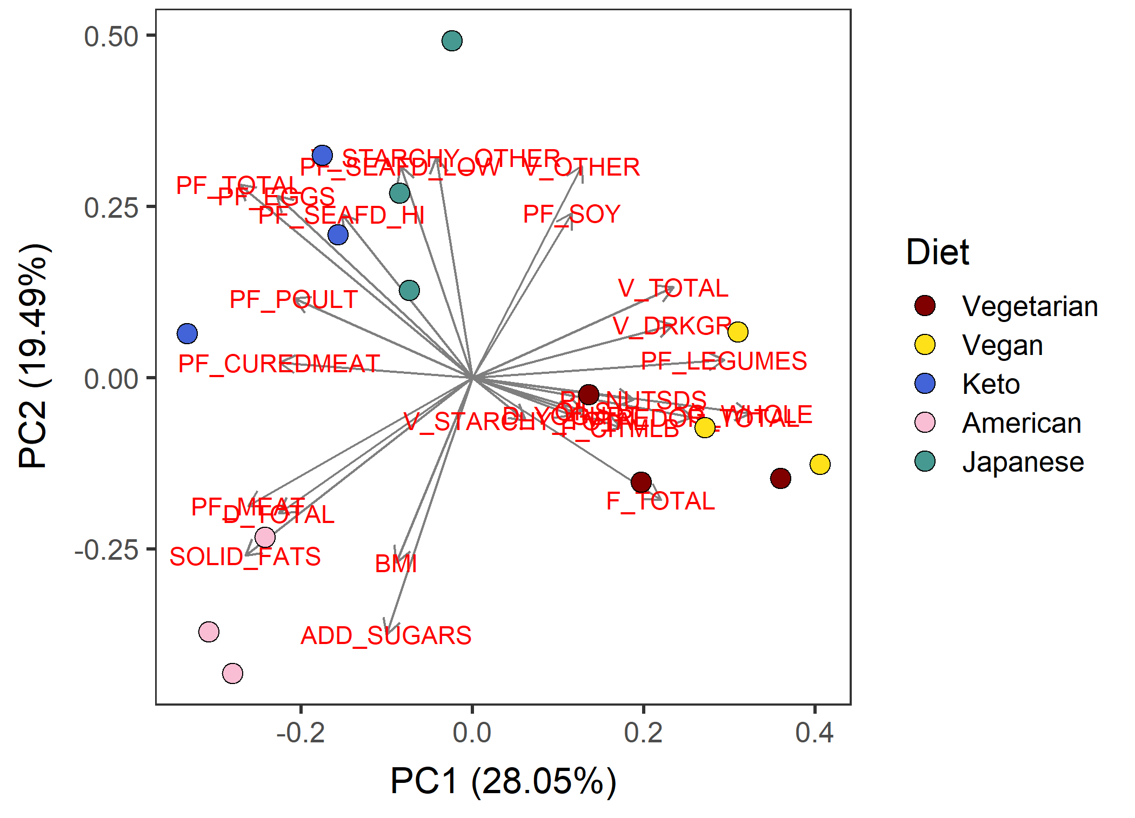
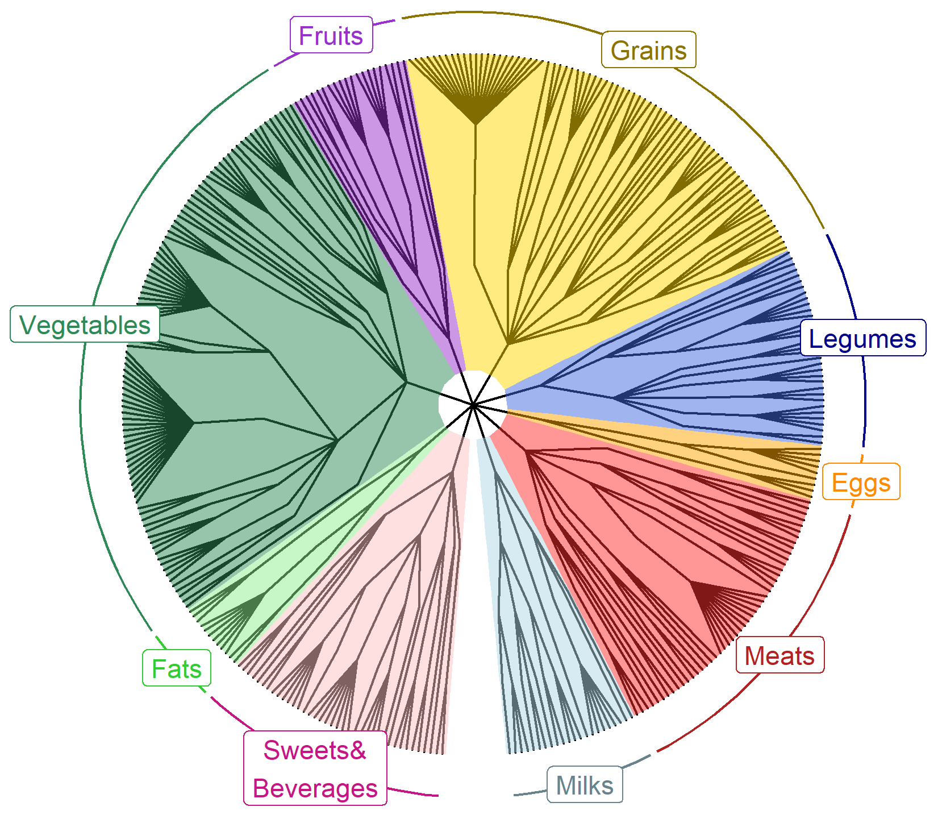
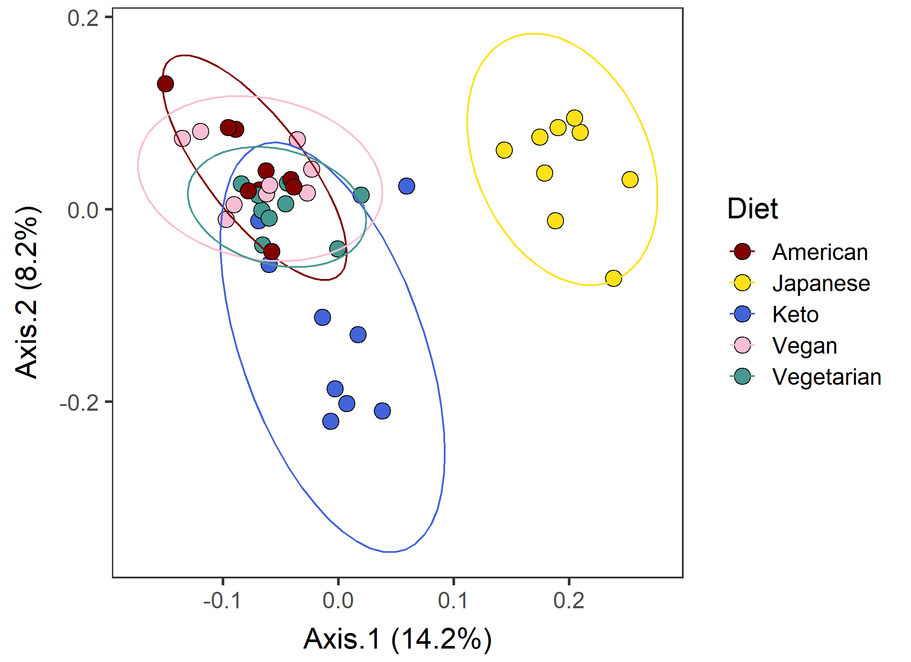





DietR –
A dietary analysis tool for ASA24 and NHANES in R
Rie Sadohara¹ , Abigail Johnson²
¹Kyoto-city, Kyoto, Japan ²Division of Epidemiology & Community Health, University of Minnesota
Background
Functionality
ASA24 and National Health And Nutrition Examination Survey (NHANES) are designed to be analyzed by using SAS
R is open-source and customizable with packages
We developed a package “DietR” to analyze NHANES and ASA24 data with R
Data preparation | Load, filter, compute total food intake for each participant and day, compute means of food intake across days/groups, filter the total data for outliers
Data overview | Data summary, % KCAL by macronutrients in barcharts
Diversity | Compute diversity indeces of dietary records
Clustering | Principal component analysis (PCA), k-means, select the optimal k
Foodtree | Build foodtrees [1] where foods in FNDDS are hierarchically grouped, visualize foodtrees, generate food OTU table (“vegan” package [2]).
Ordination | Principal Coordinate Analysis (PCoA) based on their food intake (foodtree, OTU table) with the similarity of foods taken into account (“vegan” package [2]).
Demonstration
Example dataset VVKAJ contains ASA24 dietary records of 15 people with 5 different diets, Vegetarian, Vegan, Keto, American, and Japanese for 3 days.
Data overview
Clustering
Foodtree
Ordination
%KCAL from three macronutrients. Errorbars: standard deviation.
PCA based on food categories averaged across 3 days.
4-level hierarchical grouping of all reported food items.
PCoA with consumption and food hierarchy
Case study: nuts/seeds/legumes consumption diversity & body measures
Availability
Research question
GitHub repo
Previous studies suggest nuts/seeds/legumes have positive impacts on health [3].
Is diversity of nuts/seeds/legumes consumption related to body measures, e.g. BMI or waist size?
https://github.com/computational-nutrition-lab/DietR
Methods
Website with tutorials
NHANES15-16, n=4,038, 18+ yo, with waist circumference & BMI
Foodcode 4xxxxxxxx: nuts/seeds/legumes.
Extracted reported food items with their foodcodes starting from 4.
Analysis of covariance (ANCOVA) with Age + Gender + Fiber/1000kcal + PF_ALL
https://computational-nutrition-lab.github.io/DietR/
DivGroup | n | nuts/seeds/legumes consumed | Diversity index
DivNA | 2,012 | 0 | NA
Div0 | 1,246 | 1 | 0
Div1 | 387 | >1 | 0.027 - 0.66
Div2 | 393 | >1 | 0.66 - 1.95
Preprint
https://
< 0.0001
References
< 0.0001
[1] Johnson AJ, Vangay P, Al-Ghalith GA, et al. Daily sampling reveals personalized diet-microbiome associations in humans. Cell Host Microbe. 2019;25(6):789-802
[2] Simpson GL, Minchin PR, De Caceres M, et al. vegan: Community Ecology Package. 2022
[3] Karlsen MC, Ellmore GS, McKeown N. Seeds—Health benefits, barriers to incorporation, and strategies for practitioners in supporting consumption among consumers. Nutr Today. 2016;51(1):50-59.
[4] Mitchell DC, Marinangeli CPF, Pigat S, et al. Pulse intake improves nutrient density among US adult consumers. Nutrients. 2021;13(8):2668
Results & Discussion
The more diverse nuts/seeds/legumes consumption, the lower the waist circumference.
BMI was the same except for: Div1 ≈ Div2 (not shown).
In contrast, KCAL intake was larger as the diversity increased. Similar observation has been reported by Mitchell 2021 [4] with pulses (part of legumes).
< 0.0001
< 0.0001
The high nuts/seeds/legume consumers perhaps included health-conscious population.
Physical exercise levels could be included in future studies (too few samples had data for this study).
Diversity in consumption of specific food groups instead of all foods may give novel insights.
DvGroups can further be analyzed using DietR
< 0.0001
< 0.001
0.04
< 0.01
Acknowledgements
This project was supported by internal institutional start-up funds from the University of Minnesota. The authors would like to thank Mo Hutti for the create_corr_frame function which generates a correlation table with ordination axes and variables; Pajau Vangay for the collapse_by_correlation function which removes correlated variables; and Suzie Hoops for the matrix multiplication operation and her insights into statistical analyses.
Emmeans ± SE; pairwise comparisons with no p-values are not significantly different.
For Waist and BMI, KCAL did not have a major effect to the ancova model, thus was not included.

